Slide 1
WhatsApp Chat Analysis using Machine Learning
Team Details:-
D Kranthi Kumar (20EG105109)
M Vedansh Reddy (20EG105118)
J Naveen Kumar (20EG105138)
Thoundur Preethi (20EG105151)
Project Supervisor
Name:- Mr. P Rajasekhar Reddy
Designation:- Assistant Professor

Slide 2
Introduction
WhatsApp is one of the most widely used instant messaging services globally with over 2 billion active users and has become a significant source of communication between people. WhatsApp Chat Analysis is the project we are working upon, this involves the examination of content of these conversations, the participants involved and the patterns of communication. Researchers can gather data from WhatsApp conversations to analyze various aspects of human behavior and gain insights into the way people interact with each other, how they express themselves and how they form relationships. In businesses companies can use the WhatsApp Chat Analysis to get to know their customers’ needs and preferences better by communicating with them and taking feedbacks. Sentiment Analysis which helps the computer understand the user’s emotion is also achieved here. By using WhatsApp Chat Analysis one can analyze their chats and get first hand data insights. All of this can be achieved by using Machine Learning and Python Programming. We have used Python Programming for data analysis and Machine Learning for detecting the emotion of the individual from the chat.

Slide 3
Problem Statement
Develop a machine learning-based WhatsApp chat analyzer that extracts insights from chat conversations. The system should identify frequently used words, sentiment trends, and key topics, providing users with a summarized overview of their chats. The goal is to enable users to gain valuable insights and patterns from their WhatsApp conversations.

Slide 4
Proposed Method
The “WhatsApp Chat Analysis Using Machine Learning” provides a platform to the user which enables users to analyze WhatsApp chats . We can get the insights of the chat. It becomes easy to understand the data with the help of the graphs and charts which are used to represent the data. It reduces a lot of time for analysis. Most importantly our system helps to detect the emotion of the individual by extracting the words used and running them through the Machine learning model that we have developed. It provides an upper hand to the businesses by making it easy for them to understand the customers, gaining insights into the customers interests helping them to increase their repeated customers count. It also provides the typical information such as the number of users, number of chats, most busiest days, most active hours, most active users.

Slide 5
Proposed Method
Advantages of Proposed System:
● Compatible with all devices
● Time efficient
● Easy to use
● Emotion detection
● Free to use

Slide 6
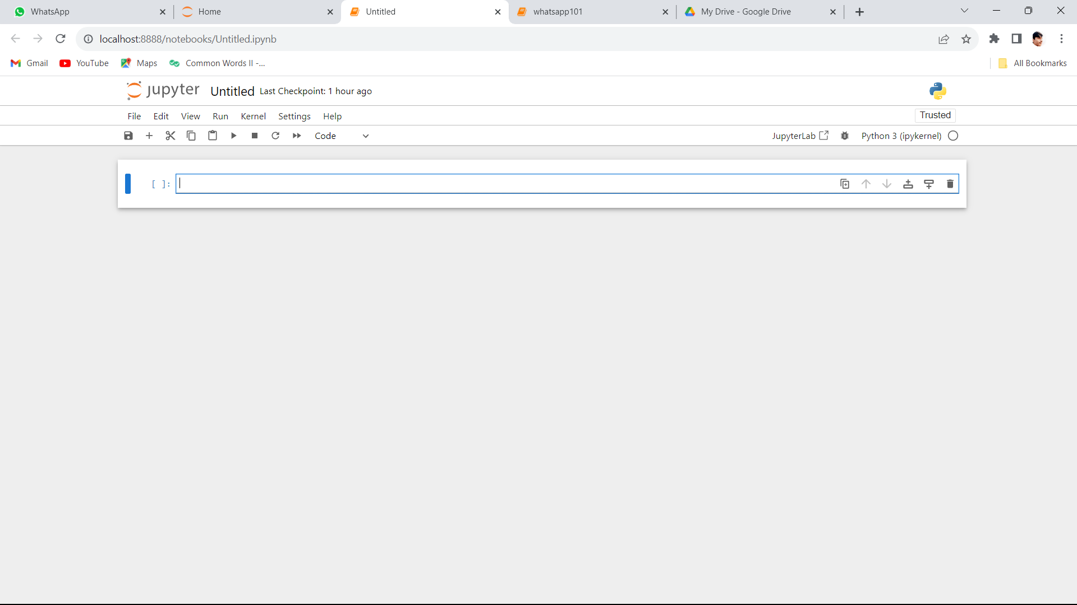
Experiment Environment
The project requires to be coded in Python and needs Machine Learning to train the raw whatsapp data and get insights from it. We needed an environment which can satisfy the needs of both Python and ML. And hence we opted to go for Jupyter Notebook. It provides a vast range of libraries which makes our task of data analysis and visualization much simpler. Also it is very easy to install more libraries if required. It is in a cell format making it easy to organize the code. We can execute the code at the end of every block so, we can correct the errors right then instead of typing the whole code, receiving errors at the end.

Slide 7
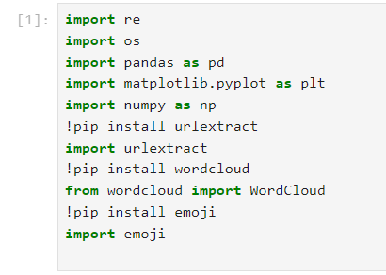
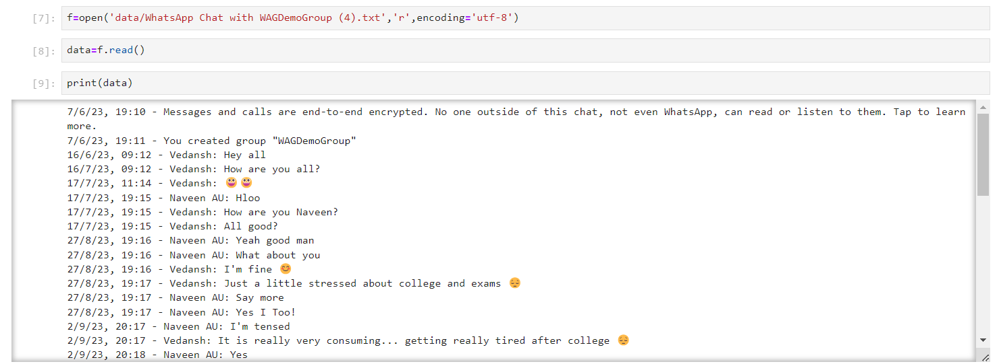
Experiment Screenshots
Importing Libraries
Exporting & Printing WhatsApp chat as dataset

Slide 8
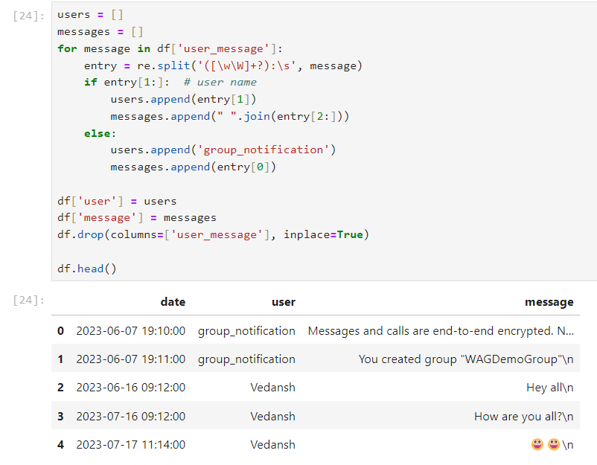
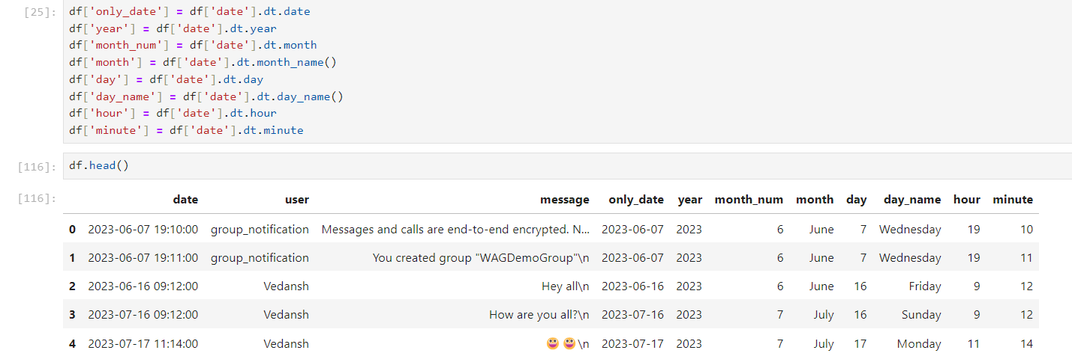
Experiment Screenshots
Splitting messages
Converting datetime data into separate columns

Slide 9
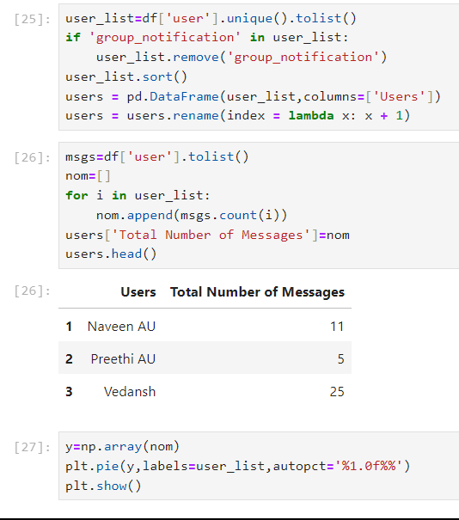
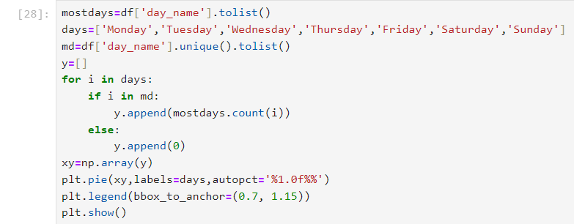
Experiment Screenshots
Unique users and total no. of messages by each
Daily analysis for busiest day pie chart

Slide 10
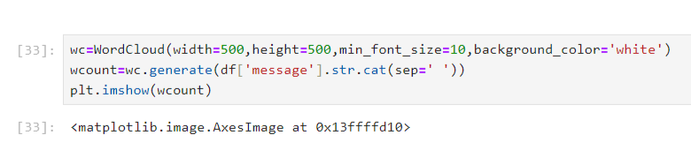
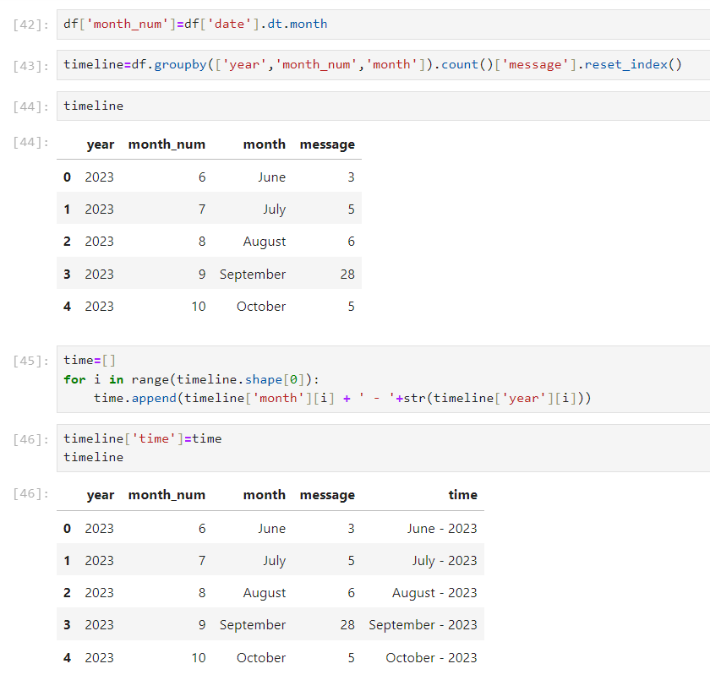
Experiment Screenshots
Wordcloud function to show commonly used words
Function for timeline graph to get monthly usage

Slide 11
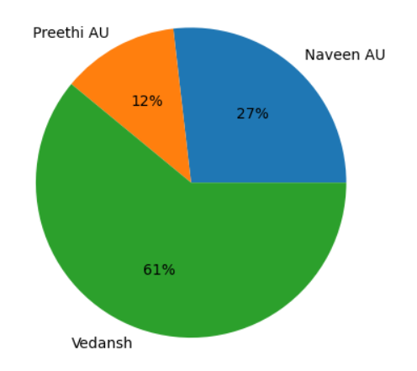
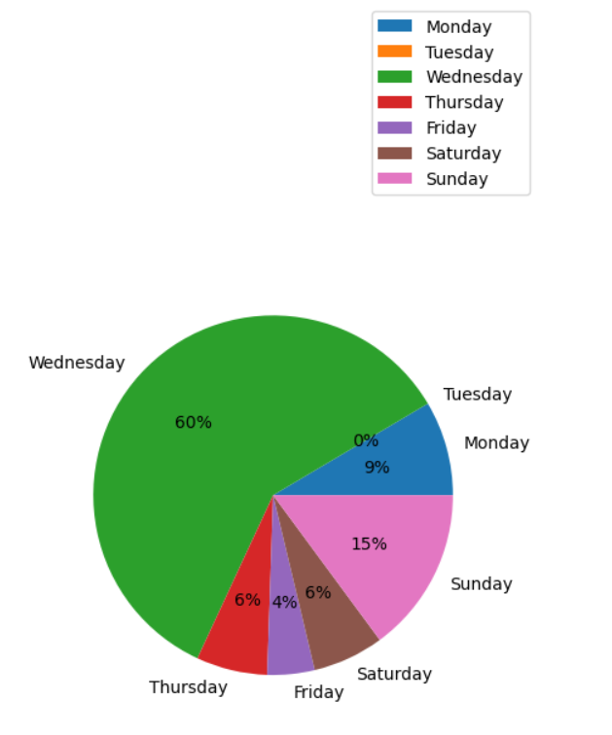
Experiment Results
Unique Users & Total Messages Pie Chart
Daily Analysis Pie Chart

Slide 12
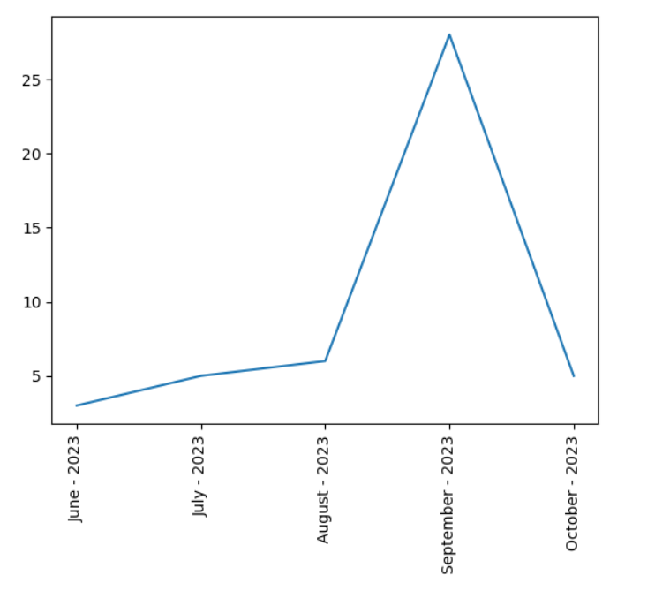
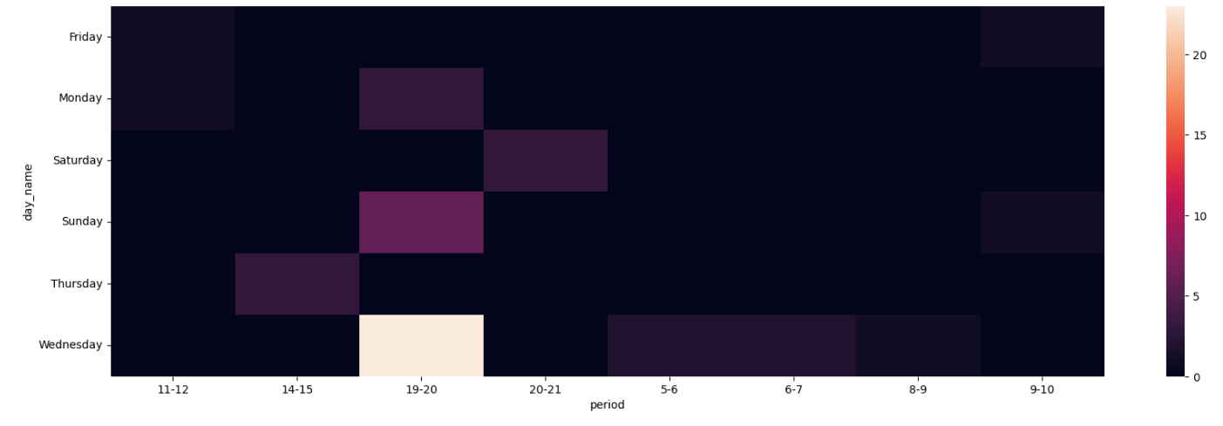
Experiment Results
Month-wise usage plotline chart
Heatmap of period of a day

Slide 13
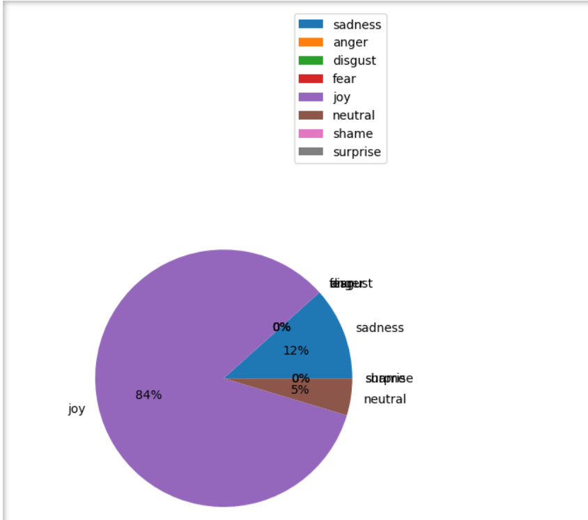
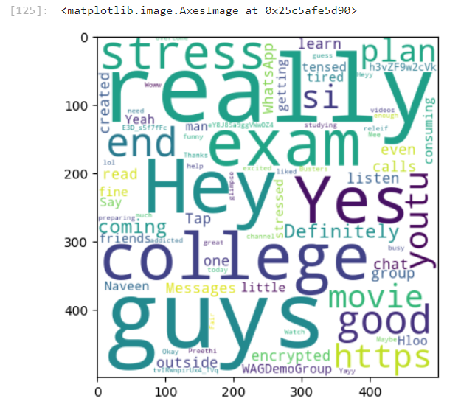
Experiment Results
Emotion Detection Chart
WordCloud for most used words

Slide 14
Finding
Previously there was no analysis for WhatsApp chat. One had to look after each and every message from the chat to extract the various information, statistics and emotions. We didn’t have a system capable to analyze thousands of messages and extract information from it. There isn’t a CSV file available for analysis if someone wants to do it.
Our proposed system, WhatsApp chat analysis using Machine Learning, provides a platform to the users which enables them to analyze through the WhatsApp chats to gain informative insights. With our model we have tried to overcome the limitations of the existing system like more time consumption, required man power, unavailability of raw data and difficulty to understand. We also have provided with the service of emotion detection, which helps to detect the emotion of the individual by extracting the words and running them through the machine learning model that we have developed. Our model is improved in the following ways:-
Easy to use
Easy to understand (through charts and graphs)
Better scalability
Emotion detection
Implementation on WhatsApp, where the identity of users is known unlike in the case of X(formerly Twitter)

Slide 15
Justification
1.What are parameters improved by your method? Why should the parameters be improved?
Earlier there was no chat analysis for WhatsApp, there was a chat analyzer for X (Twitter) based on which we have developed our project. Since, WhatsApp is one of the largest means of communication among masses, we have thought that developing a chat analyzer for an app which is used by a large population of people and whose identity is known unlike X where in some cases the user’s identity is anonymous. This would provide better insights and information about the people and their communication pattern.
Many businesses today operate through WhatsApp also. There is an option provided by WhatsApp that is known as WhatsApp business account which is specifically designed for the businesses. WhatsApp chat analyzer plays an important role here which has not been done before, i.e. it analyzes the chats with customers and provides insights to help the business improve.
Emotion detection is most pivotal feature in our model. Individual’s emotion can be detected from their chats by analyzing their texts, emojis and tone. This is important for personal usage and also professional, business usage.

Slide 16
Justification
2. Mathematic formulas for calculating parameter values
General Counting for calculating the parameters like: total number of users, total number of messages, number of text messages, number of media messages, etc. Achieved by using “count”.
To build a pie-chart of unique users, we have used the formula:-
Number of messages by a particular participant/ Total number of messages * 100; like this we
get the percentage of messages sent by a participant among a group of other participants.
To build a pie-chart of data analysis, which extracts the most busiest days based on number of messages sent on that day, we use the formula:-
No. of messages on a particular weekday/ Total no. of messages * 100

Slide 17


